Slide 1
Face recognition using Eigenfaces and Fisherfaces algorithms
-Abhinandan Veer
2Gi20ec003

Slide 2
Content:
Introduction
Principal Component Analysis (PCA)
Eigenfaces for recognition
Fisherfaces for recognition
Advantage and limitations
conclusion

Slide 3
Introduction
Face recognition is a technology that aims to identify or verify an individual's identity by analyzing and comparing their facial features.
The input of a face recognition system is always an image or video stream.
The output is an identification or verification of the subiect or subjects that appear in the image or video.
Face recognition has gained significant importance in various domains, including security, surveillance, access control, biometrics, and human-computer interaction.
Face detection Feature extraction Face recognition

Slide 4
Principal Component Analysis (PCA)
Principal Component Analysis (PCA) is a dimensionality reduction technique commonly used in face recognition algorithms like Eigenfaces.
It aims to capture the most significant variations in a high-dimensional dataset by projecting it onto a lower-dimensional subspace.
PCA achieves this by identifying the principal components, which are the eigenvectors corresponding to the largest eigenvalues of the covariance matrix of the data.

Slide 5
Eigenfaces Algorithm
Eigenfaces algorithm is a popular and widely used face recognition technique based on Principal Component Analysis (PCA).
It aims to reduce the dimensionality of face images and represent them in a lower-dimensional feature space
Steps of Eigenfaces Algorithm
Preprocessing
Data Matrix Construction
Covariance Matrix Calculation
Eigenvalue and Eigenvector Computation
Selection of Principal Component
Face Representation and Recognition

Slide 6
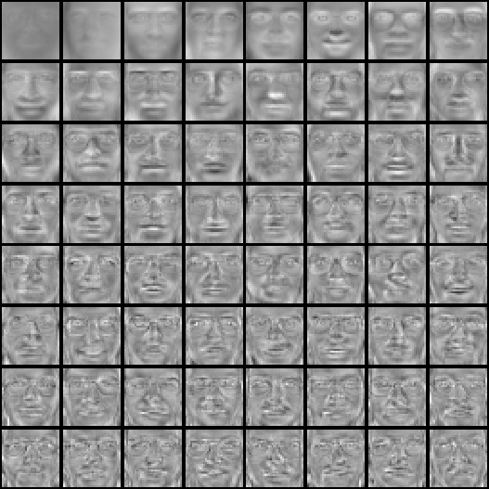
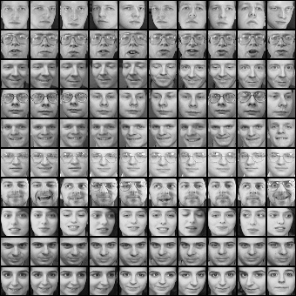
Example for eigenface to reconstructed faces

Slide 7
Fisherface
Fisherfaces is a face recognition algorithm that combines the principles of Eigenfaces with Fisher's Linear Discriminant Analysis (LDA) to improve the discriminative power of the feature space
Fisherfaces algorithm aims to maximize the separability between different classes of face images while minimizing the variations within each class.
Data is assumed to be uniformly distributed in each class.• The aim of fisherface is to maximize the ratio of the between-class scatter matrix and with-th class scatter matrix.•
It/produces good and error free results even when the illumination is varying.

Slide 8
Comparison between Fisherface and Eigenface
Eigenface tries to maximize variations while fisherface tries to maximize mean distance between various classes and minimize the variance within class.
Fisherface is based on LDA criterion while the eigenface is based on PCA.
Fisherface takes lesser space as well as has a lower error rate in comparison to Eigen

Slide 9
Advantages
Robust to variations in lighting, pose, and facial expressions.
Dimensionality reduction for faster and more efficient computations.
Effective even with small training sets.
Provides meaningful facial features.
Ease of implementation
No knowledge of geometry or specific feature of the face required.
Improved discriminative power for better separation between individuals.

Slide 10
Limitations
Good performance only under controlled background
Variations in lighting conditions
- Different lighting conditions for enrolment.
- Bright light causing image saturation.
Expression- Change in feature location and shape.
Performance decreases quickly with changes to face size
- Multi-scale eigenspaces.
- Scale input image to multiple sizes.

Slide 11
conclusion
An efficient face recognition system was set up that gave Eigenfaces, fisherfaces and also the validation between the two.
The results obtained indicated that fisherface method had lesser error rate and gives a better face recognition system.
Application of this system -> surveillance, human computer interface, law enforcement.

Slide 12
THANK YOU.

